Slide 1

Web scraping to gain company insights
By : Aldiva Wibowo

Slide 2
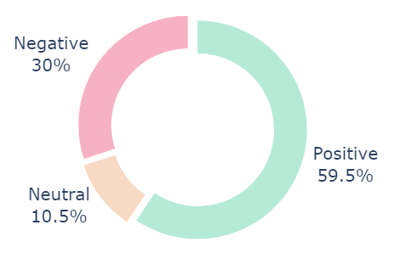
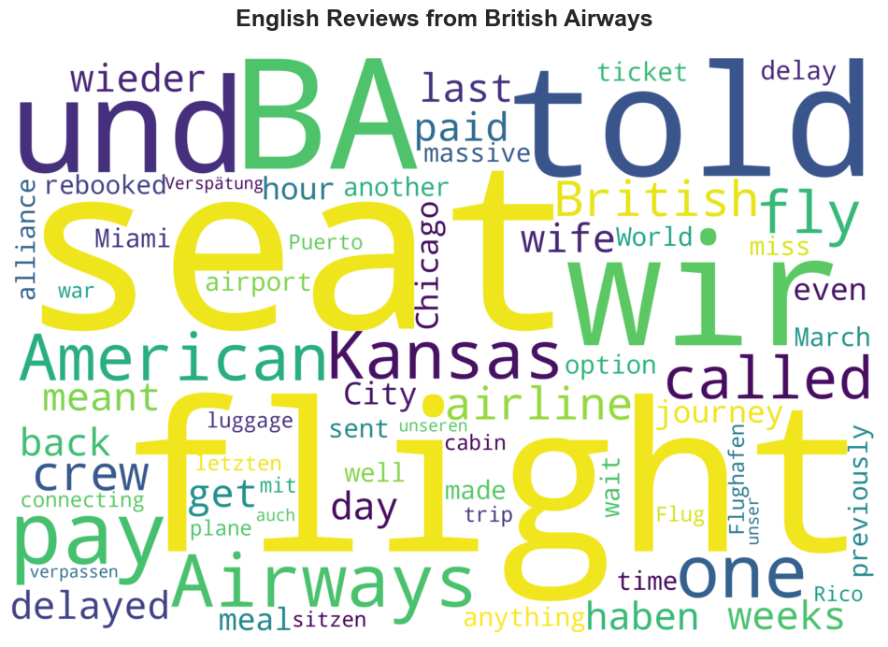
INSIGHTS FROM CUSTOMER REVIEWS
Based on the data obtained from scraping a website, there were 3507 customer reviews. Sentiment analysis was then applied to these reviews using VADER to determine the sentiment of each review. The results showed that:
59.5% of the reviews were positive (2085 reviews).
30% of the reviews were negative (1053 reviews).
10.5% of the reviews were neutral (369 reviews).
VADER is a lexicon and rule-based sentiment analysis tool that is specifically attuned to sentiments expressed in social media. It uses a combination of lexical features (e.g., words) that are mostly marked by their semantic orientation as one of positive, negative, or neutral.
Code:
Percentage of Sentiment
Word Cloud

